Slide 1


Download the My Learning App

Slide 2
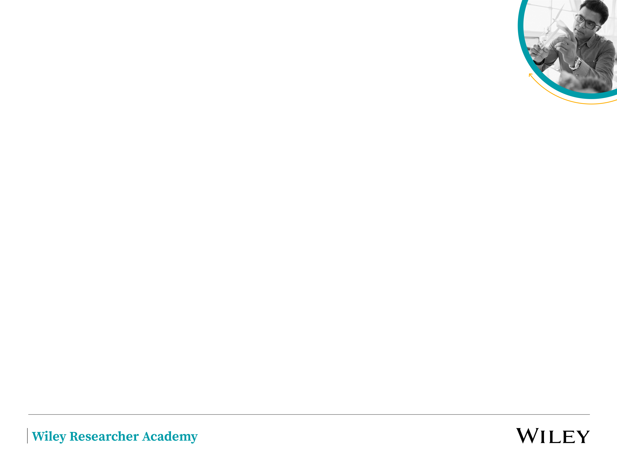
Android/IOS
Download the app through the Play Store or App Store. Once the app is installed, you can activate your profile using one of the following methods:

Slide 3
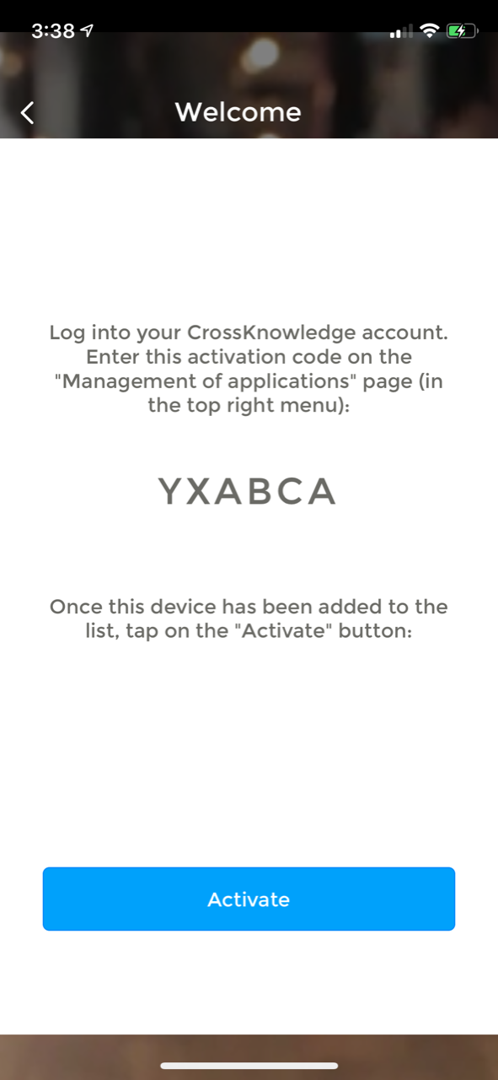
Activation using the activation code
Follow these steps on the mobile and desktop:
From your mobile select:
-An activation code is displayed. This code needs to be entered in the learner interface, on the desktop.
NOTE: Do not select “Activate” at this step!

Slide 4
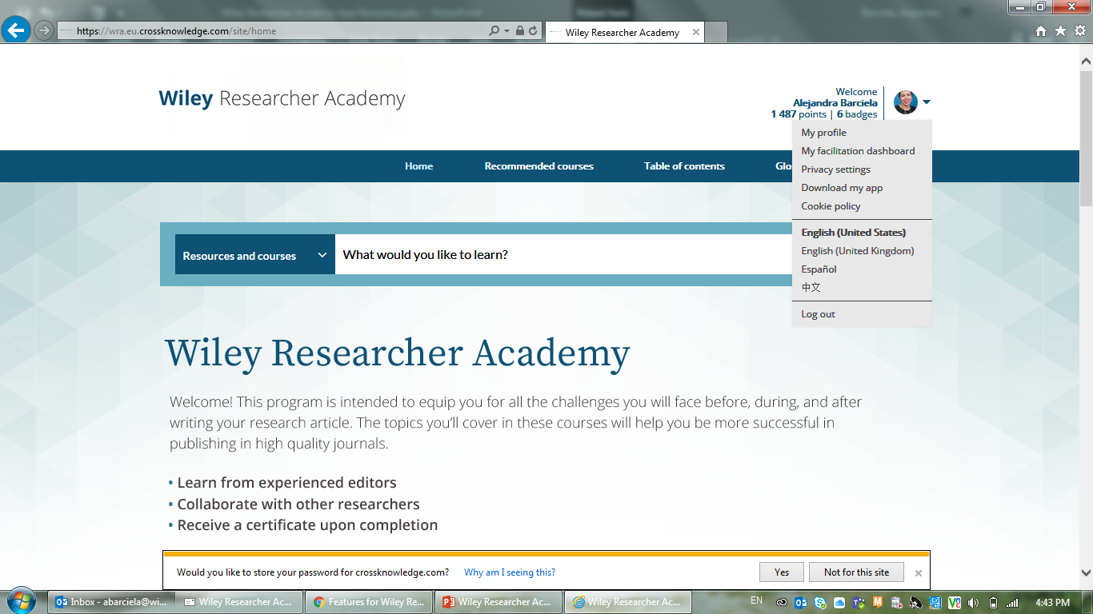
From your desktop in the learner interface, click on the learner picture on the top right corner and follow the link Download my app.

Slide 5
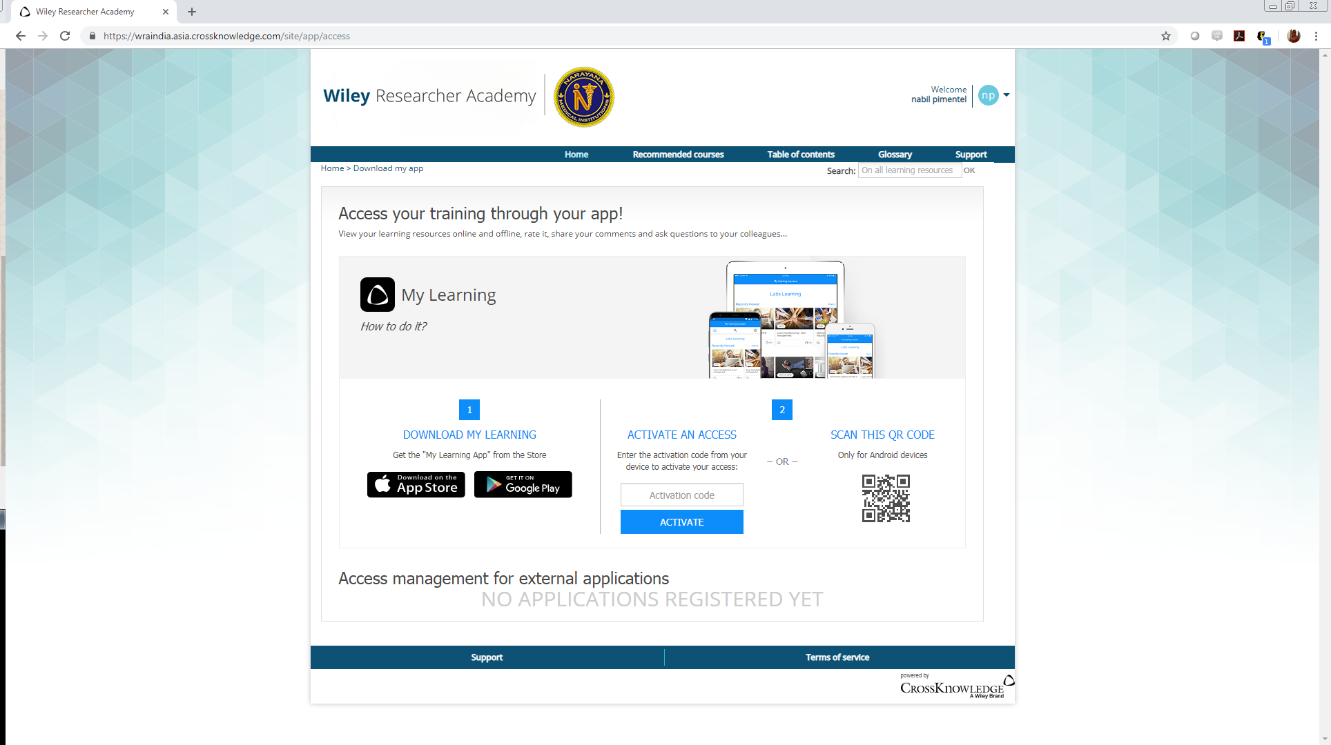
In the Activate an Access dialog box, enter the activation code displayed on the mobile device. Then click on Activate.

Slide 6
From you mobile select Activate.
-You are logged on the
My Learning App.

Slide 7
Activation using the QR code
(Android users only)
Follow these steps on the mobile and desktop:
From your mobile select:
Desktop: From your desktop in the learner interface, click on the learner picture on the top right corner and follow the link Download my app.

Slide 8
The QR code is provided in the Scan this QR code dialog box.
From your mobile scan the QR code displayed.
  -You are logged on the My Learning App.

